Slide 1
KINGDOMS OF CLASSIFICATION

Slide 2
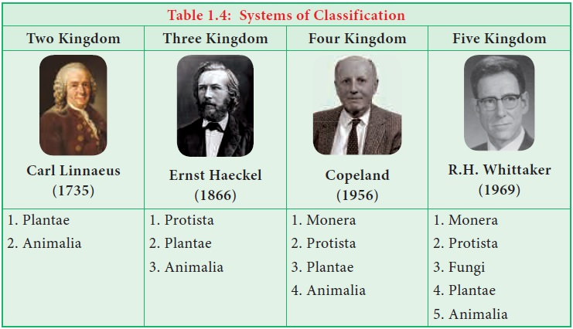
HISTORY OF CLASSIFICATION

Slide 3
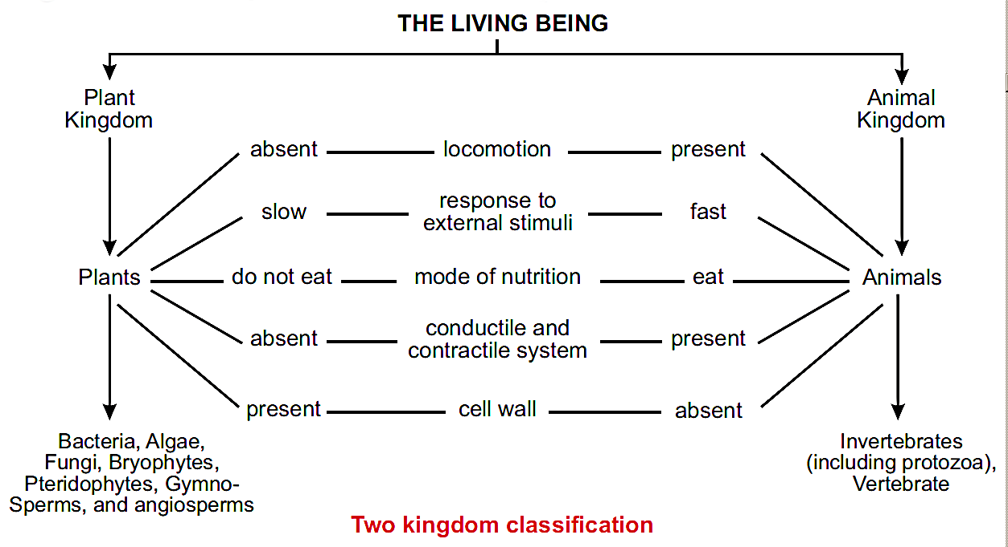
HISTORY OF CLASSIFICATION
Contribution Of Carolus Linnaeus:
Carolus Linnaeus, Swedish naturalist and explorer, was the first to frame principles for defining natural genera and species of organisms and to create a uniform system for naming them.
He divided nature into two kingdoms classification: Kingdom Plantae and Kingdom Animalia.
Carolus Linnaeus is considered as the “Father of Taxonomy”.

Slide 4
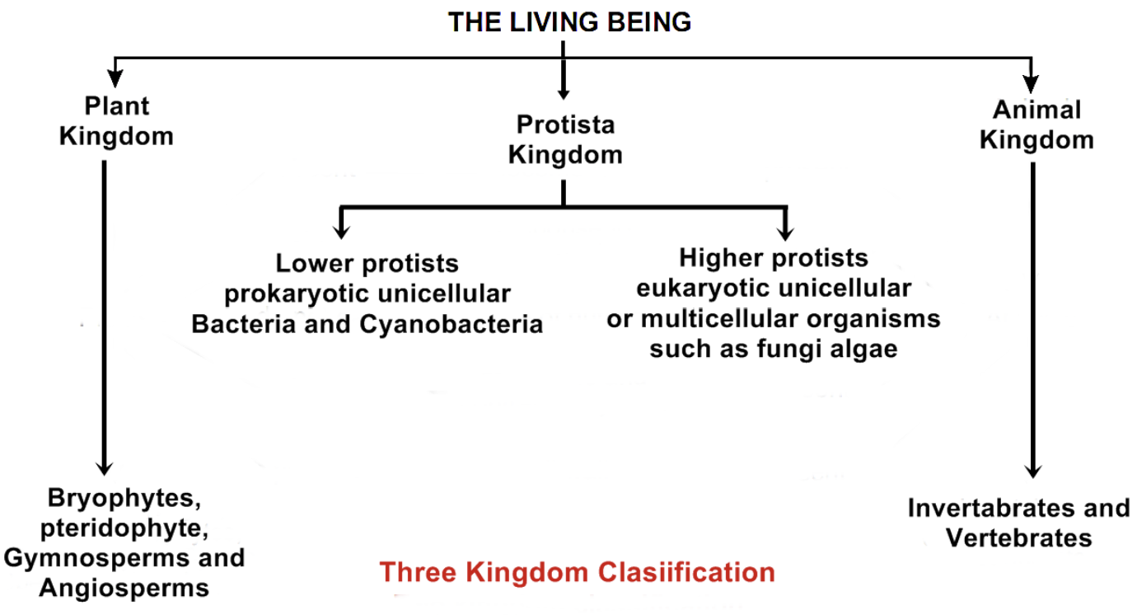
HISTORY OF CLASSIFICATION
Contribution Of Ernst Hackle in Taxonomy:
Ernst Hackle in 1866, introduced a new Kingdom named as Protista to accommodate the organism exhibiting characters either common to both plants and animals, or unique to their own such as Euglena, Bacteria were also placed under this kingdom.
He introduced three kingdom classification: Kingdom Plant , Kingdom Animal and kingdom Protista.

Slide 5
HISTORY OF CLASSIFICATION
Kingdom Plant:
All the organisms possess cell wall were placed in plant kingdom.
Organs of locomotion are absent (they can not move from one place to another by their own).
Chlorophyll is present.
Plants are autotrophic in nature (they can prepare their own food).
Conductile and contractile system is absent.
Response to external stimuli is slow.
E.g.: Bacteria, Algae, Fungi, Bryophytes, Pteridophytes, Gymno-Sperms, and angiosperms.

Slide 6
HISTORY OF CLASSIFICATION
Kingdom Animal:
All the organisms do not possess cell wall were placed in animal kingdom.
Locomotory organs are present (they can move from one place to another).
Chlorophyll is absent.
They are heterotrophic in nature (they can not prepare their own food and depends on other plants and animals for their food).
Conductile and contractile system is present.
Response to external stimuli is fast.
E.g.: Invertebrates (including protozoa), Vertebrate.

Slide 7
HISTORY OF CLASSIFICATION
Kingdom Protista:
Ernst Hackle in 1866, introduced a new Kingdom named as Protista.
The organisms exhibiting characters either common to both plants and animals, or unique to their own such as Euglena, Bacteria were also placed under this kingdom.
Haeckel grouped those living organisms in Protista which did not have tissues.
Kingdom Protista includes prokaryotes, protozoa, porifera, algae and fungi.
In 1930s, electron microscopy revealed, two distinct patterns among single celled organisms. Kingdom Protista is further divided to:
(a) Lower protists include prokaryotic unicellular Bacteria and Cyanobacteria.
(b) Higher protists include eukaryotic unicellular or multicellular organisms such as fungi and algae.

Slide 8
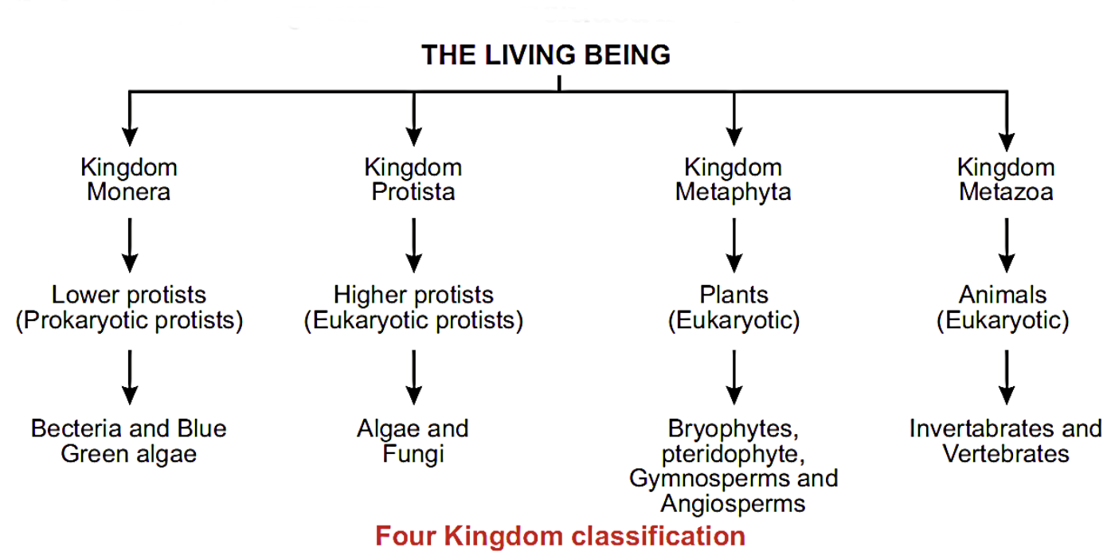
HISTORY OF CLASSIFICATION
Contribution Of Copeland (1959) in Taxonomy:
Copeland (1959) came forward with a four-kingdom system to classify the living beings.
He designed a new kingdom named as Monera to place all the lower protists which include prokaryotic unicellular organisms and remaining single celled eukaryotic organisms were included in Protista.

Slide 9
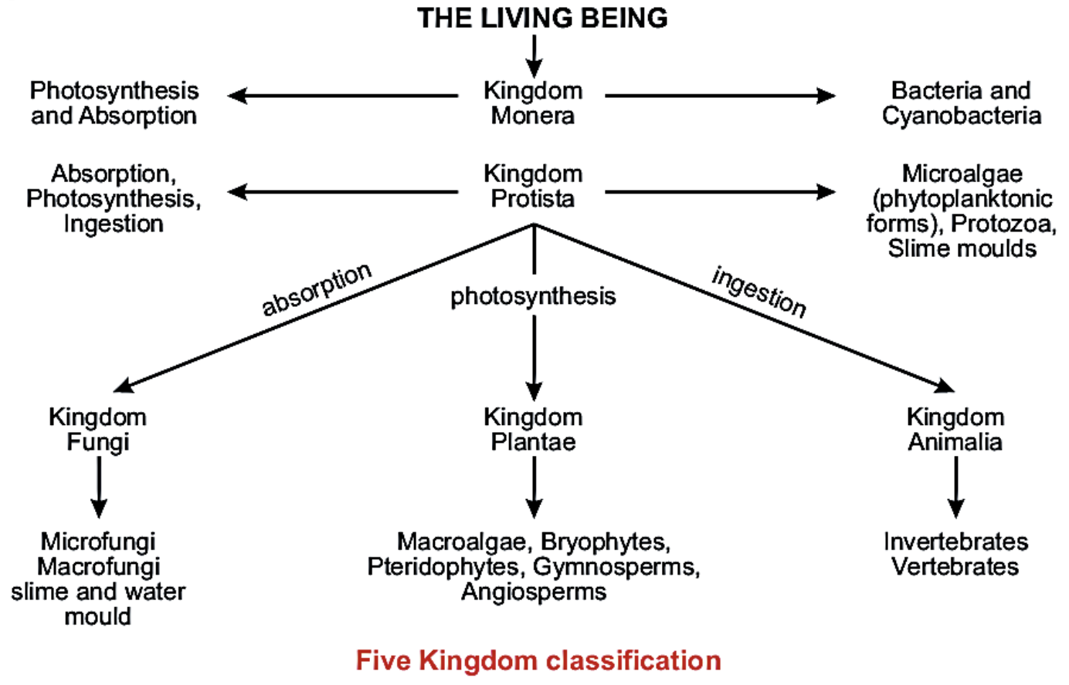
HISTORY OF CLASSIFICATION
Contribution Of Robert Whittaker:
Robert Whittaker in 1969 classified the organisms into Five kingdoms which clearly categorized fungi into a separate kingdom.
This system of classification was based on; Cellular structure and body organization; unicellular Prokaryote, Unicellular and multicellular eukaryotes. Mode of nutrition; autotrophs (plants), Ingestive heterotrophs (animals) and absorptive heterotrophs (fungi).

Slide 10
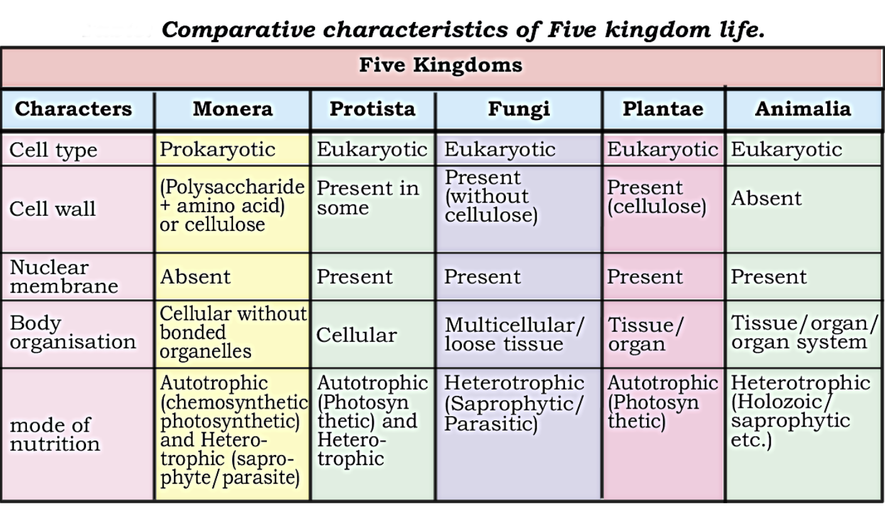
Comparative characteristics of Five Kingdom classification

Slide 11
CLASSIFICATION
Biologists mapped the whole diversity of organisms exist on earth, into simple groups. To understand about the characteristics of specific organisms individually, is simply called classification.
OR
Classification is actually based on the similar and dissimilar characteristics what organisms shared with each other and by this biologists can easily study and identify the organisms.
OR
To study such a diverse pack of organism existing on earth, biologists classified the organisms into groups and sub groups. This grouping of organisms is called biological classification.

Slide 12
Taxonomy and Taxonomic Hierarchy
Biologists classified the organisms in order to make them study easily, so the science of classification is called Taxonomy. (Taxon=group, Nomy=naming).
OR
Taxonomy can be defined as a branch of biology, which deals with the description, identification, classification and naming of living organisms according to structural similarities and dissimilarities.
The groups into which organisms are classified are known as taxonomic categories or taxa (singular taxon). The taxa are arranged in ascending order and form a ladder, called taxonomic hierarchy.

Slide 13
AIMS OF CLASSIFICATION
The main aims of this branch are:
To determine similarities and dissimilarities among organisms so that they can be studied easily.
To find the evolutionary relationship among organisms.

Slide 14
BASIS AND PRINCIPLES OF CLASSIFICATION
A system of classification is necessary because of the abundance of the variety of life on earth. There are currently around 1.5 million species that have been described and have been given scientific names. Some times it is impossible to classify organisms using external feature, therefore scientists use other characteristics to classify organisms.
Following basis and principle are used to classify living organism:
Morphological Structure: Some organisms share similar fundamental characteristics or functions. It is further explained by means of Morphology (external features of an organism) in which we study the organisms on the basis of their:
Homologous are organs of different organisms which are similar in structure and have different functions e.g. The arm of a Human being and wings of a bird or bat, Arm of Human, cat, bat and flipper of whale.
Analogous are organs of different organisms which are different in structure and have same functions. e.g. Wings of Butterfly and Bat.
Cytology: in which organisms are classified on the basis of cellular study.
Genetics: in which organisms are classified on the basis of genetic constitution and their development pattern.
Biochemistry: Biochemistry is also employed in which the chemical substances of the organisms are compared.

Slide 15

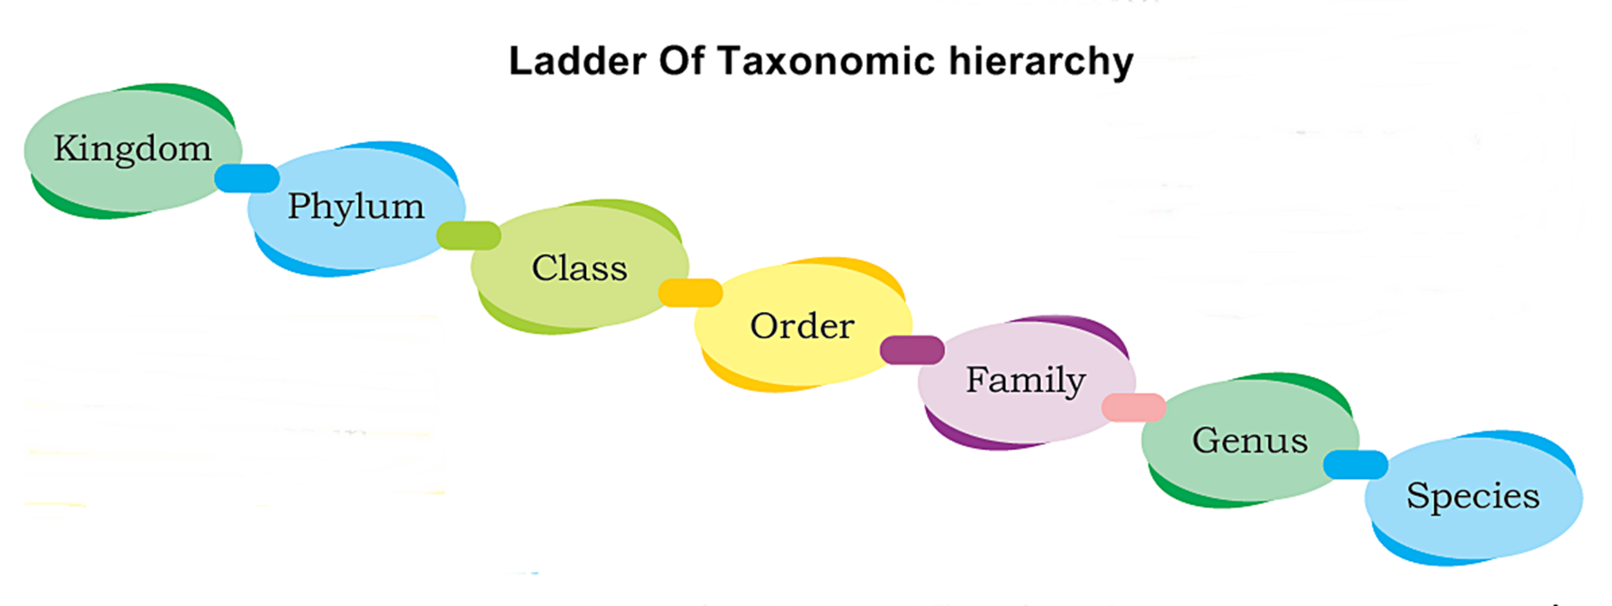

Slide 16
Ladder of Taxonomic hierarchy OR Units of classification
Following are the units of Classification:
Species: The smallest and basic unit of classification is species. Taxonomic studies consider a group of individual organisms with the fundamental similarities as a species. Thus, all the members of the particular species share the similar structure and characteristics and can naturally interbreed to produce a fertile offspring. Each species possesses its own distinct structural, ecological and behavioral characteristics.
Genera: Closely related species are grouped together into genera (singular-genus).
Families: Similar genera are grouped together into families.
Orders: Families are grouped together into orders.
Classes: Orders are grouped together into classes.
Phyla or Division: Classes are grouped together into phyla or division.
Kingdom: The kingdom is the highest taxon of classification. Phyla or Division are grouped together into kingdoms. All organisms are classified into five kingdoms. On the basis of similarities, each kingdom is further divided into smaller taxa. (Phyla - Species)

Slide 17
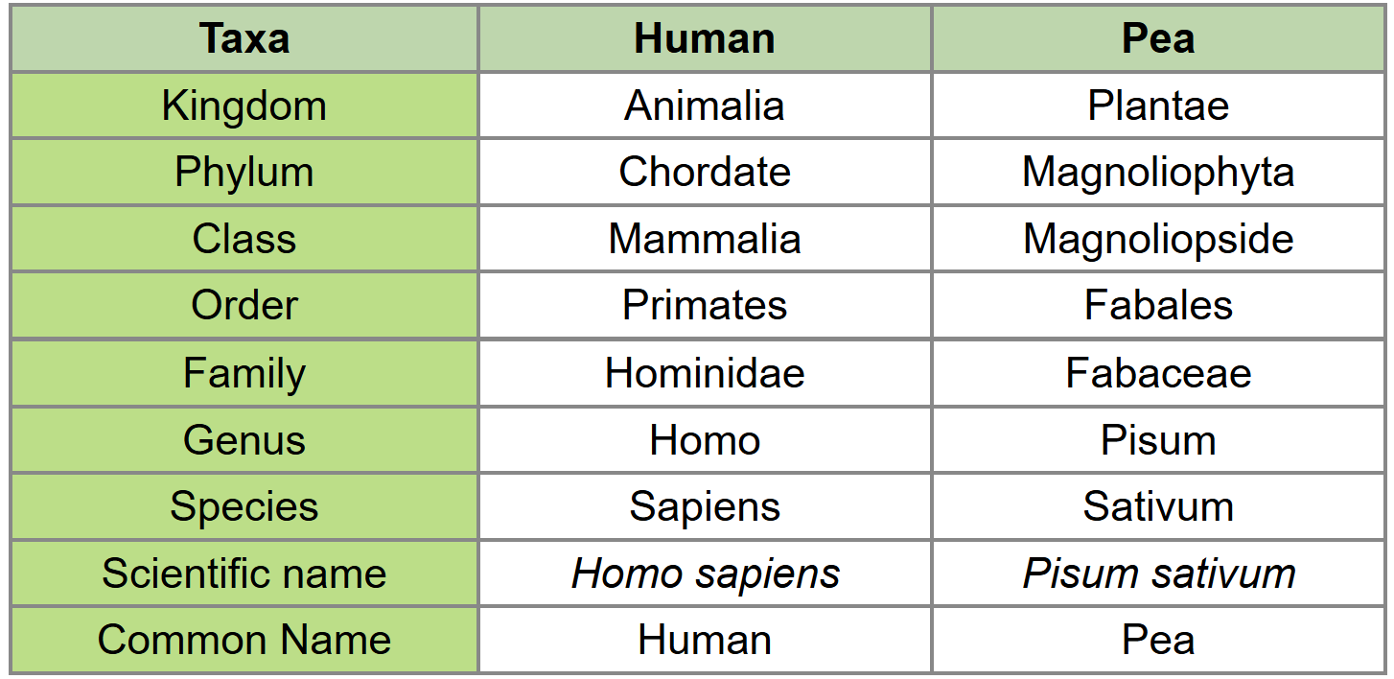
Ladder of Taxonomic hierarchy OR Units of classification
Figure: Simple Classification of Human and Pea.

